Slide 1
Attributes
Positive
Monogamy
Negative
Multiple Partners

Slide 2


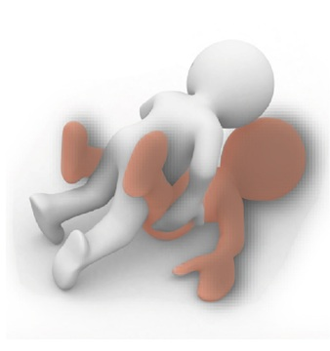

Stimuli - Monogamy

Slide 3



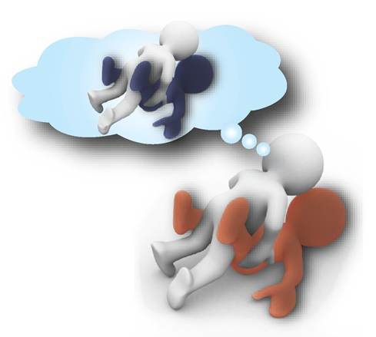
Stimuli – Multiple Partners

Slide 4




Stimuli - Positive

Slide 5




Stimuli - Negative

