Slide 1
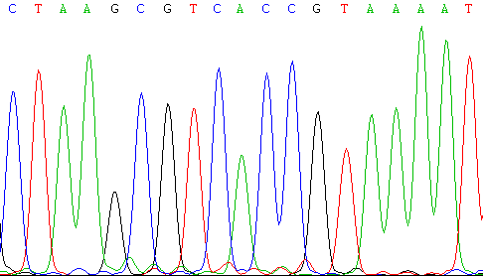
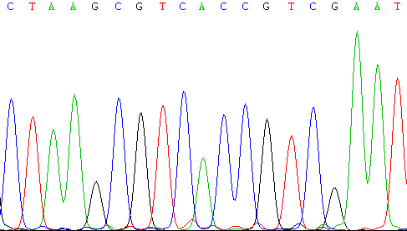
Sequencing Results
H4.1 WT
H4.1 K20R

Slide 2
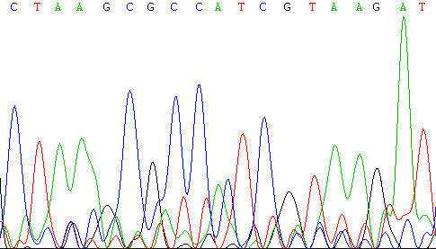
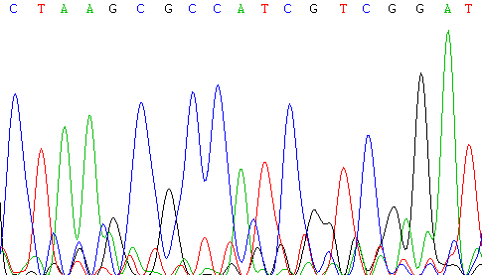
Sequencing Results
H4.2 WT
H4.2 K20R

Slide 3
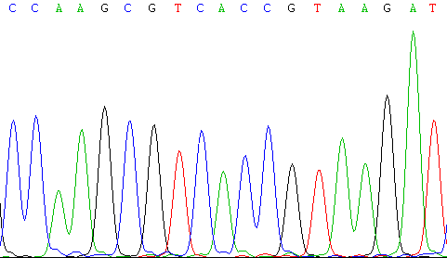
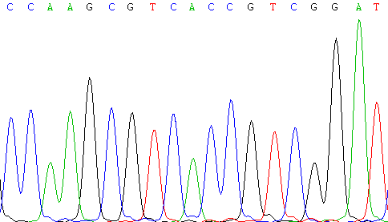
Sequencing Results
H4.3 WT
H4.3 K20R

